Slide 1
Unity Bootcamp
UCF CAP6121
Spring 2019
Kevin Pfeil

Slide 2
Learn Something
Get Unity3D
Understand Unity3D
Use Unity3D

Slide 3
Get Unity
https://store.unity.com/download?ref=personal
Multiple versions available
Basic version is free and sufficient for projects
Pro licenses available for advanced usage

Slide 4
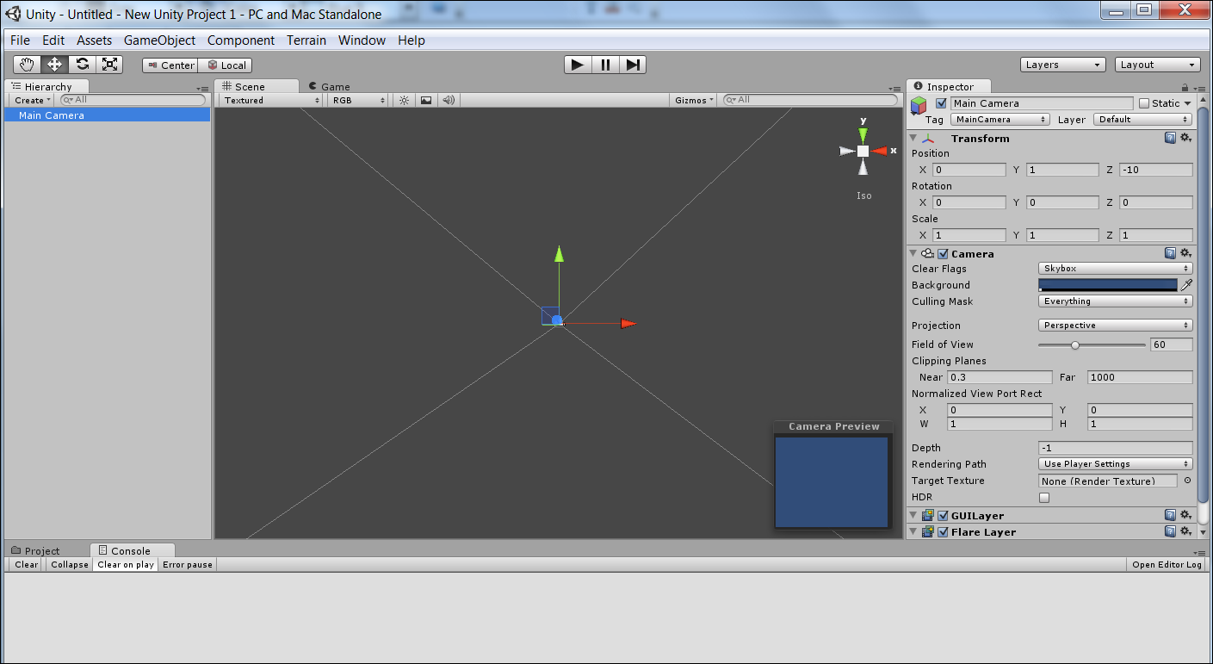
Understand Unity

Slide 5
Understand Unity
Game Objects
Hierarchy
Scene/Game Viewers
Object Inspector
Console / Project Assets

Slide 6
Understand Unity
Game Object Hierarchy
  As you place new things into the world, they are listed in the hierarchy
    Camera(s)
    Scenery Objects
    Player Avatar
    Etc.
  Click on an object to see/edit details in Inspector
  Double click on object to zoom to it in the Scene

Slide 7
Understand Unity
Scene Viewer
  Displays objects in the game world
  Multiple ways to view your world
  Game Objects can be manipulated directly
Game Viewer
  Displays objects according to the game camera
  Consider it as a way to “preview” the world without running the whole game

Slide 8
Understand Unity
Inspector
  For selected Game Object, displays components
  Components take many forms that affect how the game object looks/behaves
    Scripts, Meshes, Colliders, Audio Sources...
  Most components can be modified in Inspector
    Object “Transform” (position, rotation, scale)
    Mesh properties
    Script variables
    Etc.

Slide 9
Understand Unity
Console
  Displays errors, warnings, debugging lines, etc.
Project Assets
  Quick way to get to prefabs, scripts, and other resources that are part of the project

Slide 10
Understand Unity

Slide 11
Use Unity
Get Game Objects into the World
  Create “primitives” such as sphere, cube, etc.
  Drag Prefabs into the scene from Project tab
Modify Game Objects
  Add components (meshes, textures, scripts)
Press Play!

Slide 12
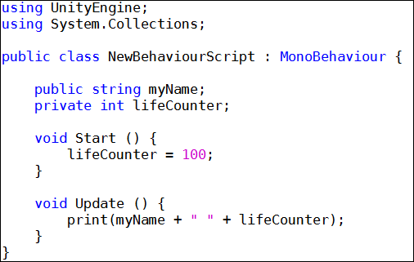
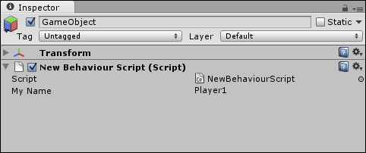

Scripting
While Unity has built-in physics, this is not enough for your custom projects
Custom Scripts are used to build specific behaviors for Game Objects

Slide 13
Our First Game
Create a game world
Add the Player
Add Scenery
  Terrain
  Trees
  Water
Add an NPC
  Graphics
  Sound effects
  Scripted behaviors
Live Demo!

